Slide 1
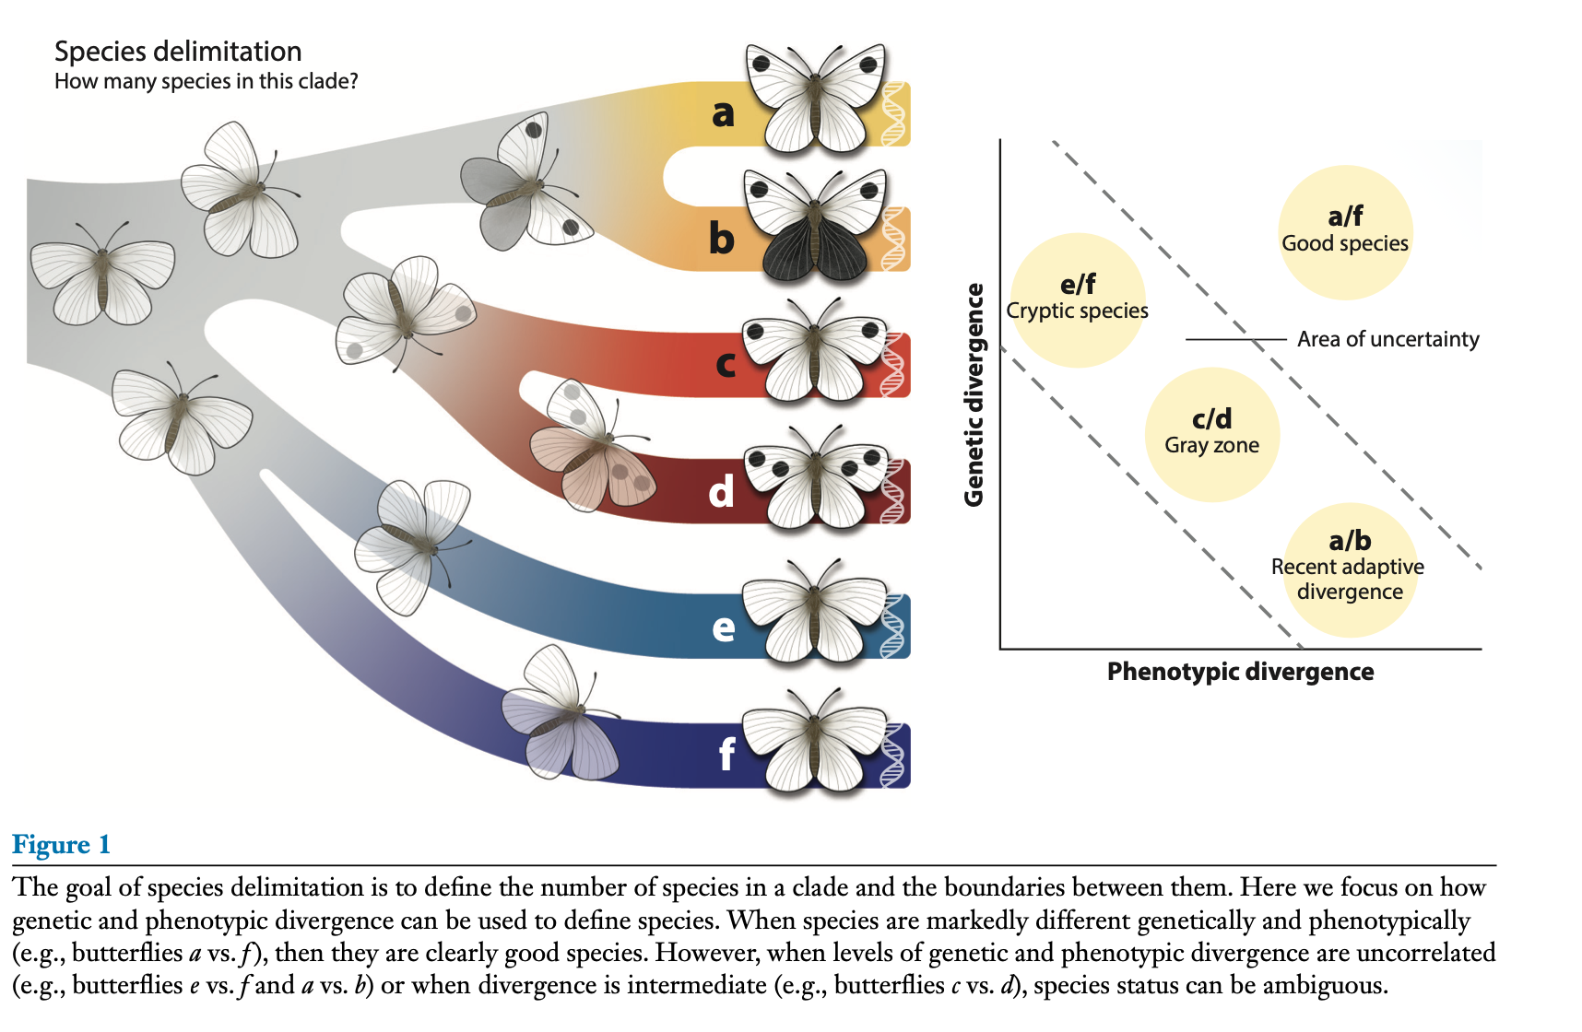
Sonal Singhal, Adam D. Leaché,
Matthew K. Fujita, Carlos Daniel Cadena, and Felipe Zapata. 2025. “A Genomic Perspective on
Species Delimitation” Annu. Rev. Ecol. Evol. Syst. 2025. 56:467–89
https://doi.org/10.1146/annurev-ecolsys-102723-
055311
Class focus area: Species delimitation
EEB603: Brian O’Meara
All quotes and images from the above paper unless otherwise noted

Slide 2
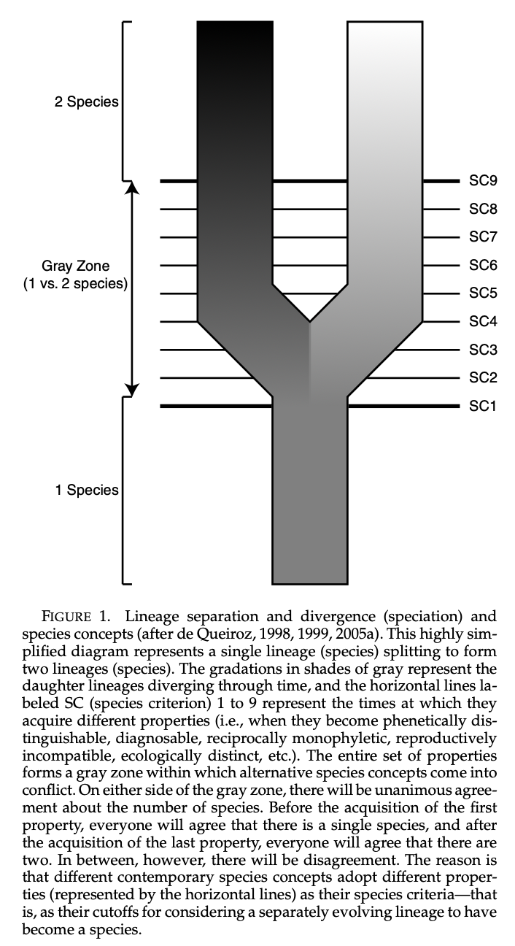
de Queiroz 2007

Slide 3
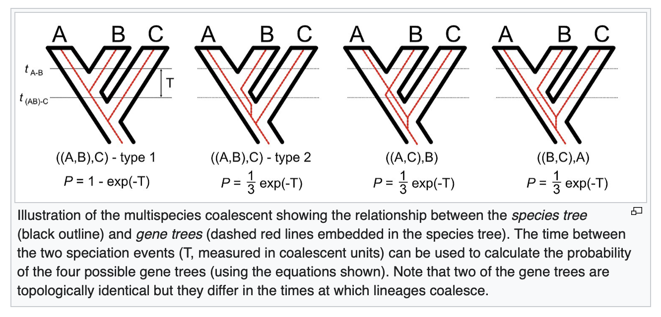
Wikipedia Sept 12, 2025: Multispecies Coalescent

Slide 4
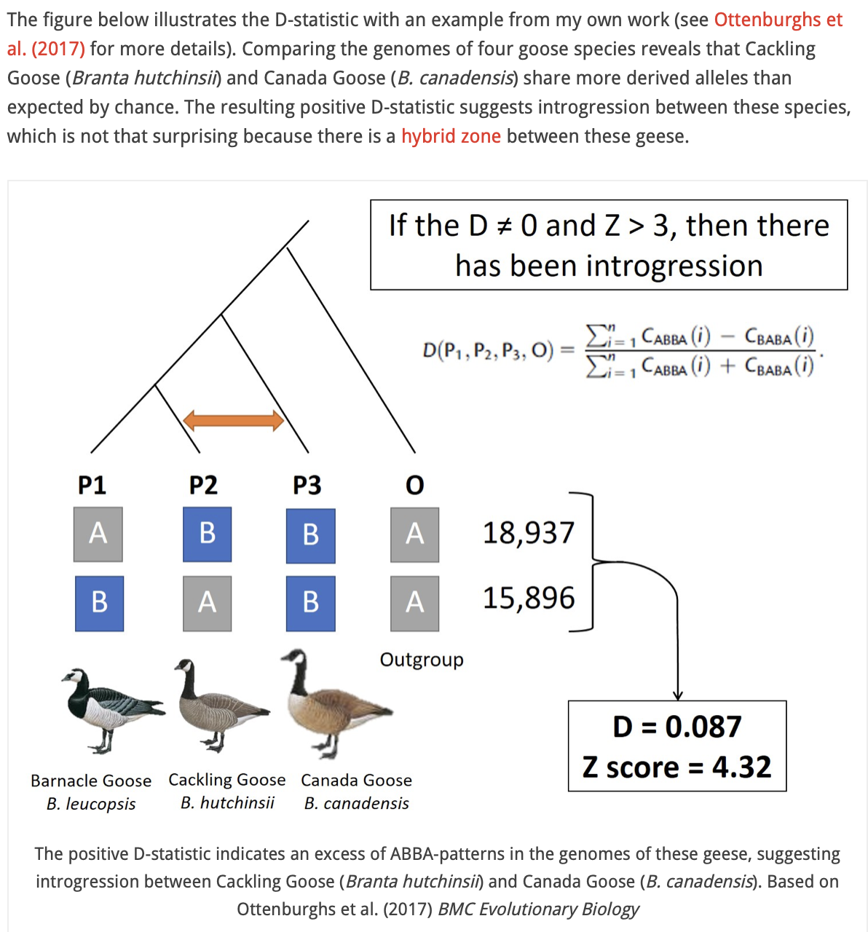
Jente Ottenburghs: https://avianhybrids.wordpress.com/2019/11/09/d-statistics-for-dummies-a-simple-test-for-introgression/

Slide 5
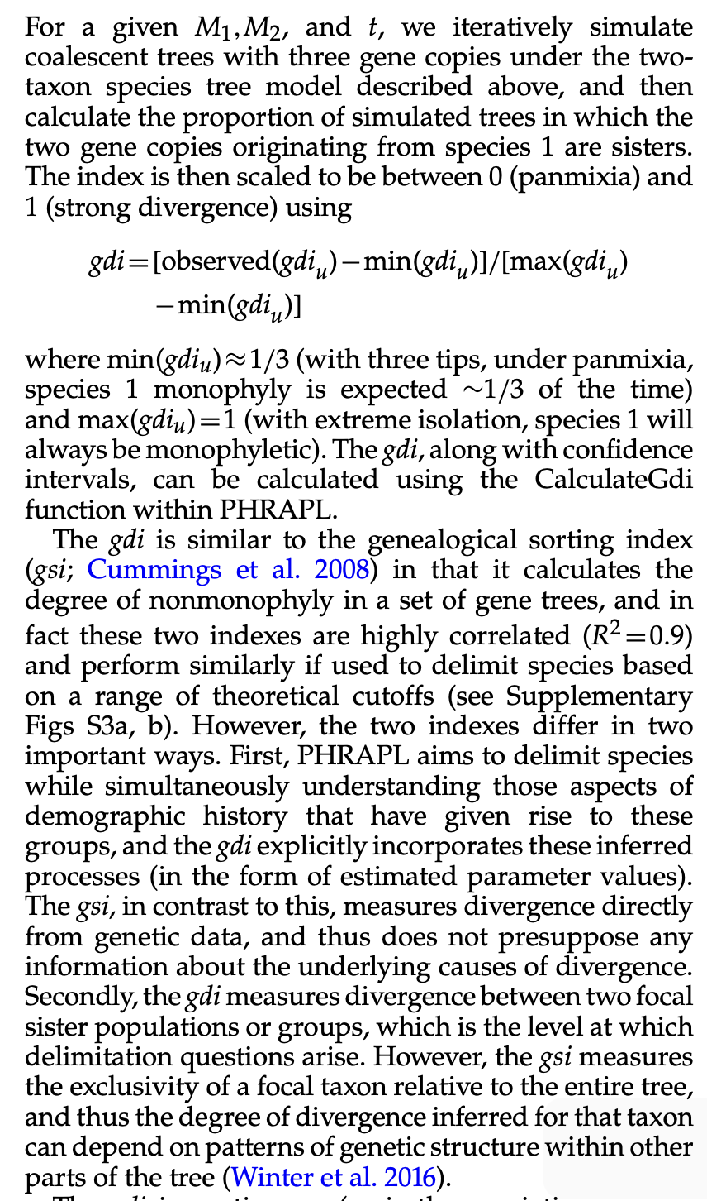
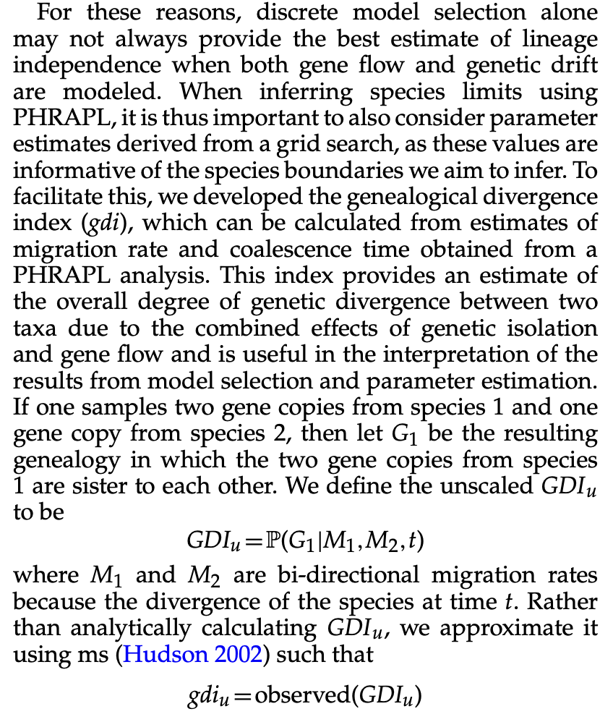
Jackson et al. 2017

Slide 6
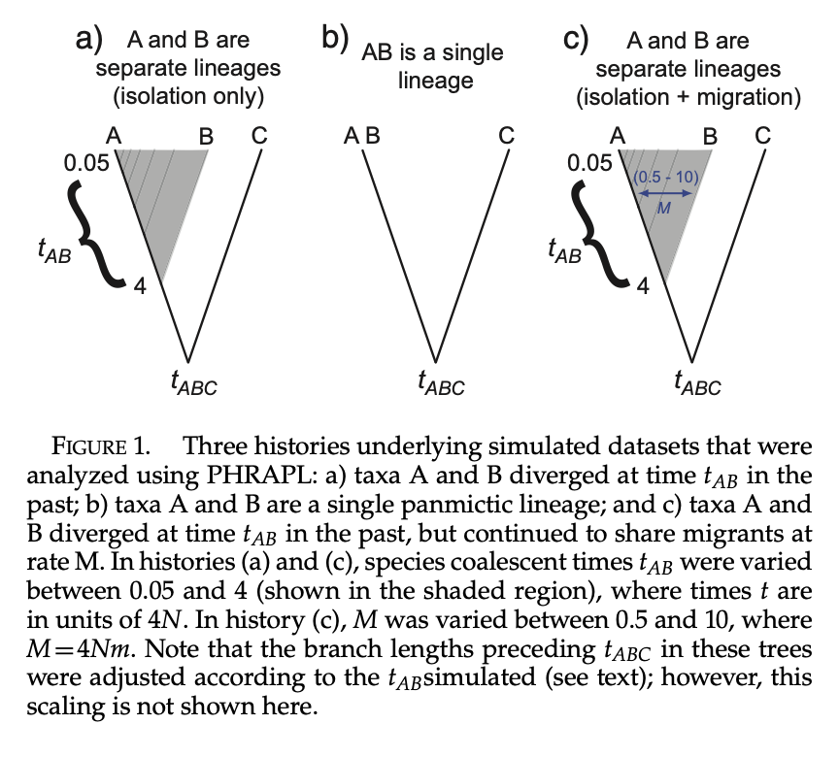
Jackson et al. 2017

Slide 8
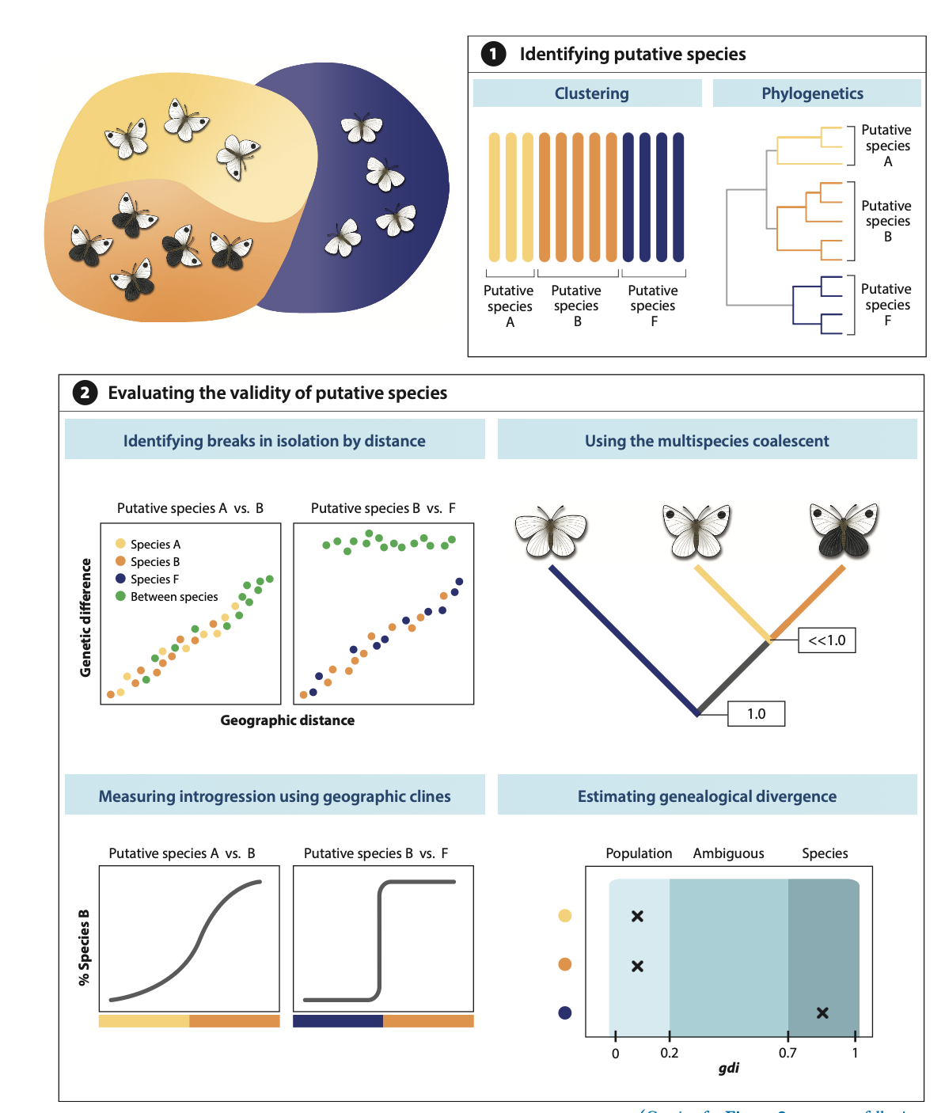

Slide 9
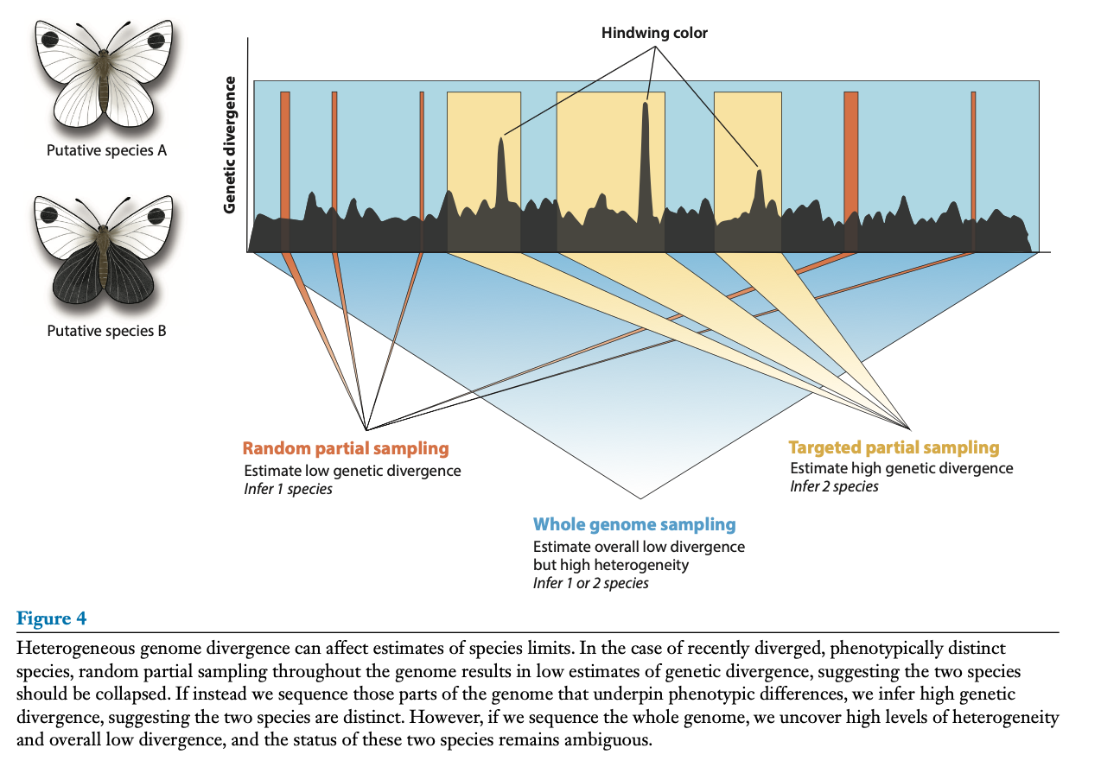

Slide 10
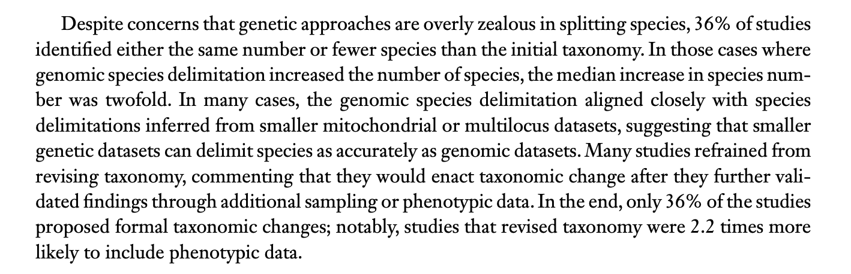

Slide 11
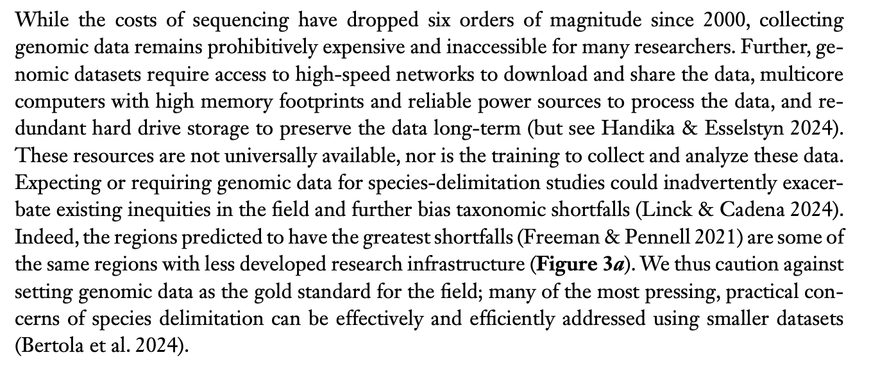

Slide 12
